Slide 1

Intro to Complexity Theory
Computability theory (1930s - 1950s):
The main question: “Is a language decidable or not?”
Complexity theory (1960s - present):
The main question: “Is a language decidable with restricted resources?”
(time/memory/…)
Example: Let $A=\left\{{\text{a}}^{k}{\text{b}}^{k} | k≥0\right\}$.
Q: How many steps are needed to decide $A$?
Depends on the input.
We give an upper bound for all inputs of length $n$.
Called “worst-case complexity”.

Slide 2





# steps to decide $A=\left\{{\text{a}}^{k}{\text{b}}^{k} | k≥0\right\}$
Theorem: A 1-tape TM $M$ can decide $A$ where, on inputs of length $n$, $M$ uses at most $cn^{2}$ steps, for some fixed constant $c$.
Terminology: $M$ uses $O(n^{2})$ steps.
Proof: $M=$“On input $w$
1. Scan input to check if $w∈{\text{a}}^{∗}{\text{b}}^{∗}$, reject if not.
2. Repeat until all crossed off.
Scan tape, crossing off one a and one b.
Reject if only a’s or only b’s remain.
3. Accept if all crossed off. ”
Analysis:
$O\left(n\right)$ steps
$+O(n)$ iterations
$×O(n)$ steps
---------------------------
$O\left(n\right)+O(n^{2})$ steps
$=O(n^{2})$ steps
Big $O:$ Defn: $f(n)$ is $O\left(g\left(n\right)\right)$ if $f\left(n\right)≤cg(n)$ for some fixed $c$ independent of $n$.
$$M$$
a
a
a
a
b
b
b
b
˽

Slide 3




Deciding $A=\left\{{\text{a}}^{k}{\text{b}}^{k} | k≥0\right\}$ faster
Theorem: A 1-tape TM $M$ can decide $A$ by using $O(n\log{n)}$ steps.
Proof:
$M=$“On input $w$
1. Scan tape to check if $w$ $∈{\text{a}}^{∗}{\text{b}}^{∗}$. Reject if not.
2. Repeat until all crossed off.
Scan tape, crossing off every other a and b.
Reject if even/odd parities disagree.
3. Accept if all crossed off. ”
Analysis:
$O\left(n\right)$ steps
$+O(\log{n})$ iterations
$×O(n)$ steps
---------------------------------
$O\left(n\right)+O(n\log{n})$ steps
$=O(n\log{n})$ steps
a
a
a
a
a
a
b
b
b
b
b
b
˽
 | Parities
a’s | even (6) | odd (3) | odd (1)
b’s | even (6) | odd (3) | odd (1)
$$M$$

Slide 4




Deciding $A=\left\{{\text{a}}^{k}{\text{b}}^{k} | k≥0\right\}$ faster
Theorem: A multi-tape TM $M$ can decide $A$ using $O(n)$ steps.
$M=$“On input $w$
1. Scan input to check if $w$ $∈{\text{a}}^{∗}{\text{b}}^{∗}$, reject if not.
2. Copy a’s to second tape.
3. Match b’s with a’s on second tape.
4. Accept if match, else reject. ”
Analysis:
$O\left(n\right)$ steps
$+O(n)$ steps
$+O(n)$ steps
------------------
$=O(n)$ steps
$$M$$
a
a
a
a
a
a
b
b
b
b
b
b
˽
˽
˽
˽
˽
˽
˽
˽
˽
˽
˽
˽
˽
˽
a
a
a
a
a
a

Slide 5

Model Dependence
Number of steps to decide $A=\left\{{\text{a}}^{k}{\text{b}}^{k} | k≥0\right\}$ depends on the model.
1-tape TM: $O(n\log{n)}$
Multi-tape TM: $O(n)$
Computability theory: model independence (Church-Turing Thesis)
Therefore, model choice doesn’t matter. Mathematically nice.
Complexity theory: model dependence
But dependence is low (polynomial) for reasonable deterministic models.
When we talk about low dependency, we compare it with exponential complexities.
We will focus on questions that do not depend on the model choice.
We will continue to use the 1-tape TM as the basic model for complexity.

Slide 6



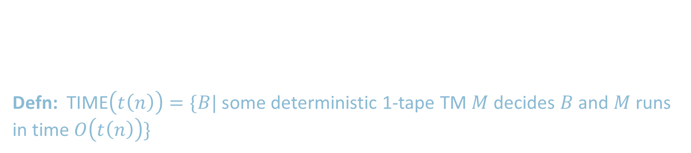


TIME Complexity Classes
Defn: Let $t: ℕ→ℕ$. Say TM $M$ runs in time $t(n)$ if $M$ always halts within $t(n)$ steps on all inputs of length $n$.
Defn: TIME$\left(t\left(n\right)\right)=\{B|$some deterministic 1-tape TM $M$ decides $B$ and $M$ runs in time $O\left(t\left(n\right)\right)\}$
. . .
$$\text{TIME}\left(2^{n}\right)$$
$$\text{TIME}\left(n^{3}\right)$$
. . .
$$\text{TIME}\left(n^{2}\right)$$
$$\text{TIME}\left(n\log{n}\right)$$
$$\text{TIME}\left(n\right)$$

Slide 7






The Class P
Defn: P$=\bigcup_{k}{\text{TIME}(n^{k})}$ : The collection of all languages with polynomial time complexity
$=$ Union of all polynomial time decidable languages
P = O(n) U O(n²) U O(n³) U O(n⁴) U …
$$G$$
Example: $PATH=\left\{〈G,s,t〉\right| G$ is a directed graph with a path from $s$ to $t$ $\}$
Theorem: $PATH∈\text{P}$
Proof: $M=$“On input $〈G,s,t〉$
1. Mark $s$
2. Repeat until nothing new is marked:
For each marked node $x$:
Scan $G$ to mark all $y$ where $\left(x,y\right)$ is an edge
3. Accept if $t$ is marked. Reject if not.
$$s$$
$$t$$
$≤n$ iterations
$× ≤n$ iterations
$× O\left(n^{2}\right)$ steps
-------------------
$O(n^{4})$ steps
To show polynomial time: Each stage should be clearly polynomial and the total number of stages polynomial.

Slide 8

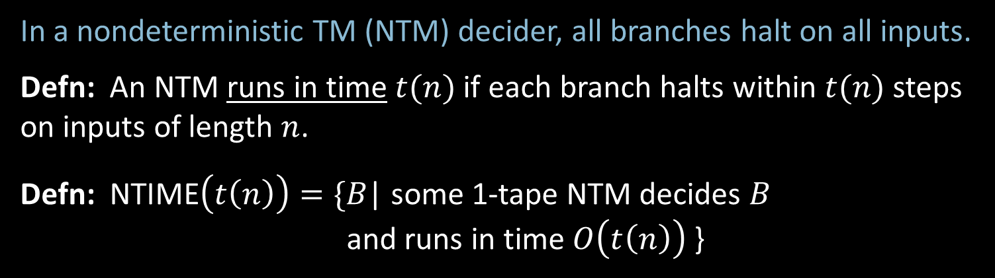



Nondeterministic Complexity
In a nondeterministic TM (NTM) decider, all branches halt on all inputs.
Defn: An NTM runs in time $t(n)$if each branch halts within $t(n)$ steps on inputs of length $n$.
Defn: NTIME$\left(t\left(n\right)\right)=\{$𝐵| some 1-tape NTM decides 𝐵 and runs in time $O\left(t\left(n\right)\right)$ }
Computation tree for NTM on input $w$.
The Class NP:
NP$=\bigcup_{k}{\text{NT}\text{IME}(n^{k})}$
$=$ Union of all nondeterministic polynomial time decidable languages
L is in NP if, given a proposed solution, we can verify its correctness in polynomial time.
$$t\left(n\right)$$
. . .
all branches halt within $t(n)$ steps

Slide 9

Intuition for P and NP
P: is the class of languages for which a membership test can be solved in polynomial time.
Like, determining whether a given input is in the language takes polynomial time.
NP: is the class of languages for which a solution can be verified in polynomial time.
Like, if you are given a candidate solution to a problem, you can check whether this solution is valid in polynomial time.
P $⊆$NP
Question: P = NP? Famous unsolved problem (Cook 1971).
Conjecture: P ≠ NP. Some problems are NP and not in P.
P
NP

Slide 10

Satisfiability Problem
A Boolean formula $φ$ has Boolean variables (True/False values) and Boolean operations And ($∧$), Or ($∨$), and Not ($¬$).
Defn: $φ$ is satisfiable if $φ$evaluates to True for some assignment to its variables.
Sometimes we use 1 for True and 0 for False.
Example: Let $φ= \left(x∨y\right)∧(\overline{x}∨\overline{y})$ (Notation: $\overline{x}$ means $¬x$)
If x=1, y=0, then $φ$ is satisfiable
Defn: $SAT=\left\{〈φ〉\right| φ$ is a satisfiable Boolean formula}
$SAT∈$ NP
Cook’s Theorem: If we prove $SAT∈$ P $→$ P = NP
Proof method: polynomial time reducibility

Slide 11




Polynomial Time Reducibility
A ≤_{p}​B means taking example formula of A and convert it to B in polynomial time. In this case, if B can be solved in polynomial time, then A is also can be solved in polynomial time.
Theorem: If $A≤_{P}B$ and $B∈$P then $A∈$ P.
All problems in NP are polynomial time reducible to SAT.
NP
$$SAT$$
P
$$≤_{P}$$
Idea to show if $SAT∈$ P $→$ P = NP
Notes:
A ≤_{p}​B: A is reducible to B in polynomial time.
SAT is in the NP

Slide 12
NP-Hard, NP-Complete
NP-Hard: The problem is at least as hard as NP
Every problem in NP can be reduced to a problem in NP-Hard set
NP
NP-Hard
P
NP-Complete
Complexity
NP-Complete: The Np-Hard problems that has non-deterministic algorithm

Slide 13
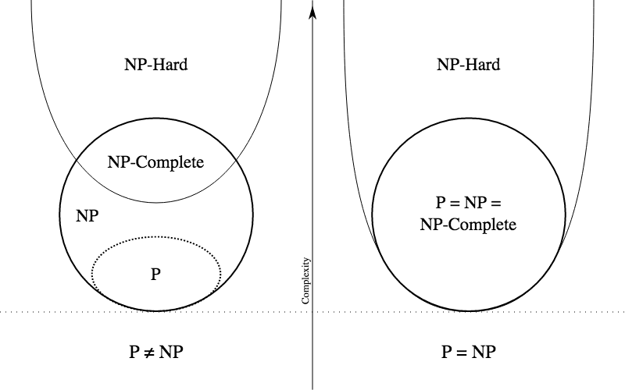
Is P=NP?
Nobody knows!
If we can solve one problem in the NP-complete set in polynomial time, we can solve all problems in the NP-complete set in polynomial time

